Slide 1

 | S.S.V.P.S’s B. S. Deore Polytechnic, Dhule Department of Computer Engineering Academic Year : 2025 – 2026
Presentation on Capstone Project Execution (CPE–316004)
Topic | Student Freelance Marketplace
Presented by | 1. Narayani Satish Patil
 | 2. Kaveri Devendra Pawar
 | 3. Paurnima Mahesh Thakurware
 | 4. Mitesh Ajabsingh Padvi
Guided by | Ms. Mansi Manikhedkar
Semester | Sixth (K Scheme) | Date :

Slide 2
Abstract
This project is a Student Freelance Marketplace Website that connects work providers and student freelancers on one platform. Users can register, log in, choose their role, post work, send proposals with bid amount and delivery time, chat in real-time, track project status, and make secure payments with a 50% advance system.
The platform focuses on academic, technical, and skill-based services such as projects, assignments, PPT design, website development, and logo creation. It also includes profile verification, wallet payment, and a review and rating system to ensure trust and transparency.
The marketplace focuses on academic, technical, and skill-based services such as mini and final-year project development, assignment and notes creation, PPT and design work, website development, database design, logo creation, and college event support. With features like proposal bidding, file sharing, email verification, profile validation, wallet system, and delivery tracking, the platform ensures efficient collaboration between students and clients.

Slide 3
Content
Introduction (background of the industry or used based problem / task)
Literature Survey
Scope of the project
Methodology
Details of designs, working and processes
Results and applications
Conclusion and future scope
References and Bibliography

Slide 4
1. Introduction
The Freelancer Website is an online platform designed to connect freelancers with clients who require professional services. In today’s digital world, many individuals prefer flexible working opportunities, while businesses often need skilled professionals for short-term or project-based tasks. This website provides a convenient environment where freelancers can showcase their skills, experience, and portfolios, while clients can easily find and hire suitable professionals for their projects.
The platform includes features such as user registration, login authentication, project posting, freelancer profiles, and categorized job listings. Clients can post their project requirements, browse freelancer profiles, and select the best candidate for their work. Freelancers, on the other hand, can explore available projects and apply according to their expertise.
The main aim of this website is to simplify the hiring process, promote remote working opportunities, and create a reliable marketplace for freelance services. By using modern web technologies, the system provides a simple, responsive, and user-friendly interface that makes collaboration between freelancers and clients more efficient.

Slide 5
2. Literature Review
These platforms connect freelancers with clients for project-based work.
They provide features like user registration, profile creation, project posting, and bidding systems.
Rating and review systems help maintain service quality.
Categorization of services makes it easier to find specific skills.
Responsive web design improves accessibility on different devices.
A user-friendly interface and proper service categories improve user experience.
These studies helped understand the design and working of freelancer platforms and guided the development of the proposed website.

Slide 6
3. Scope of the project
The website includes different service categories such as web development, graphic design, writing, etc.
Clients can post project requirements and job descriptions.
Freelancer can browse available projects and apply for them.
The website includes different service categories such as web development and
Graphic design, writing, etc.
The system provides a simple and user-friendly interface for easy navigation.
The website is responsive and accessible on different devices.
Future improvements may include online payments, messaging system, and review system.
Users can register and create accounts on the platform.

Slide 7
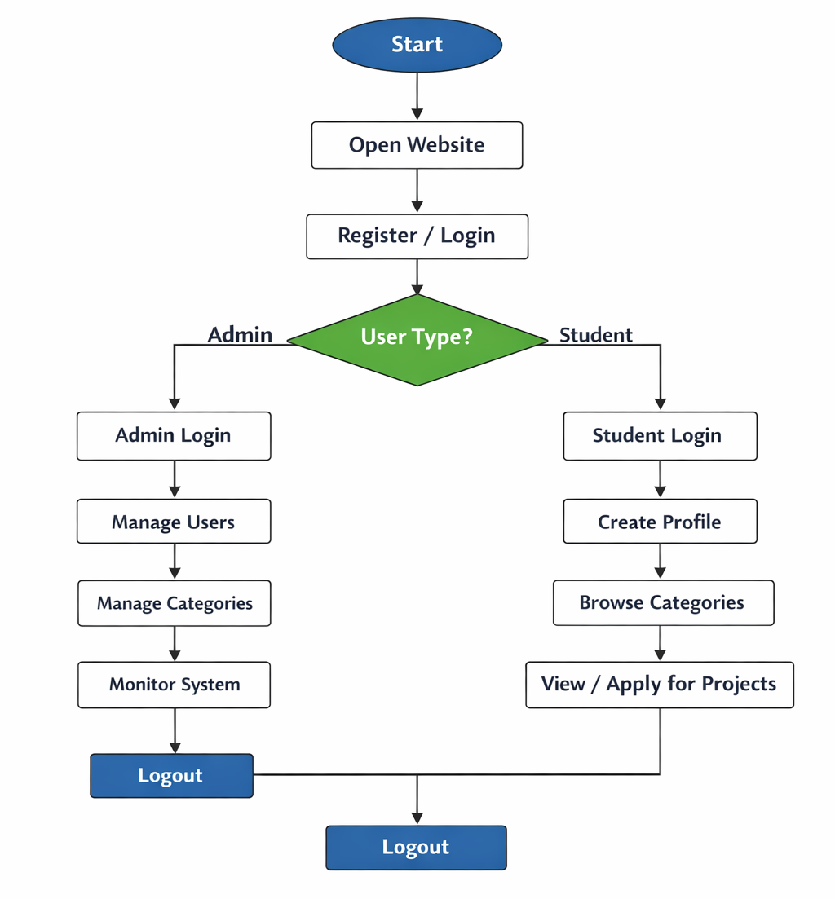
4. Methodology

Slide 8
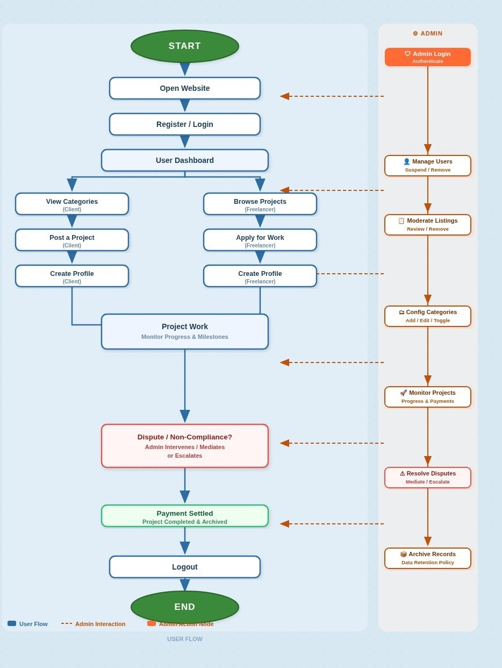
Admin panel

Slide 9
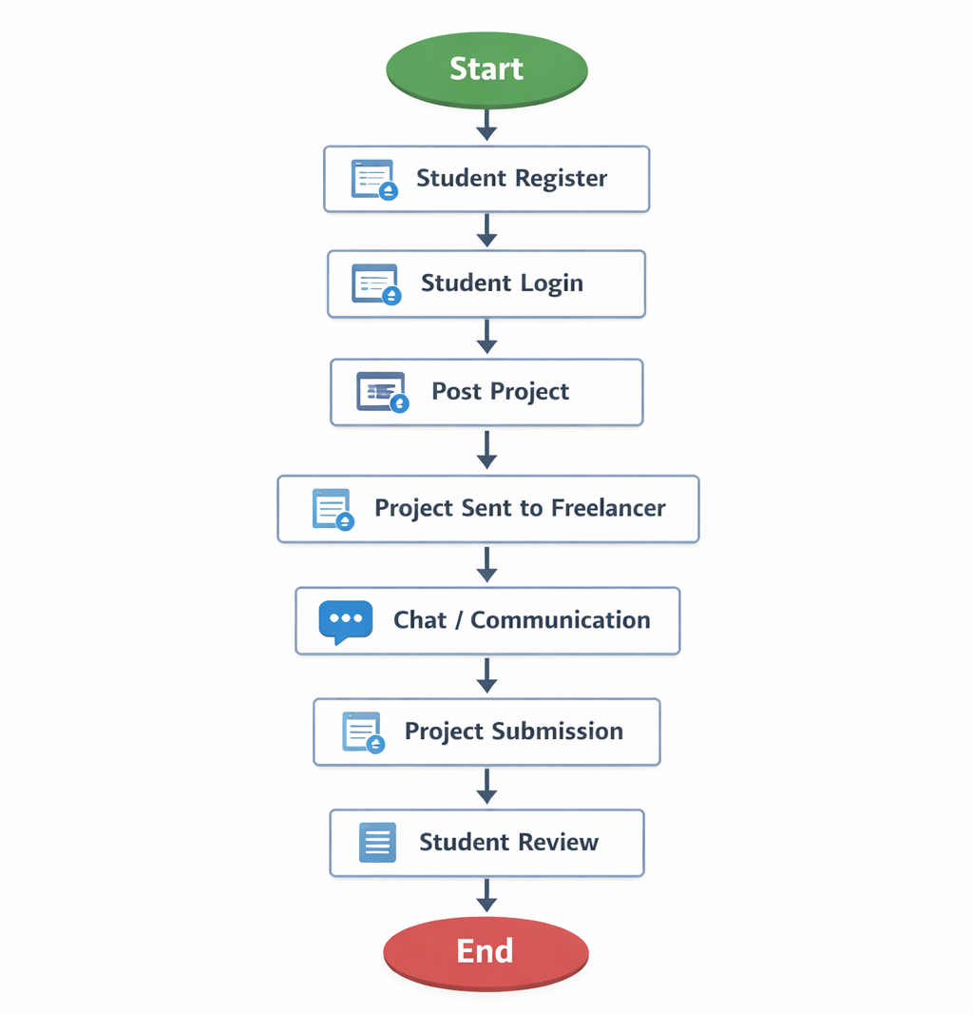
Student panel

Slide 10
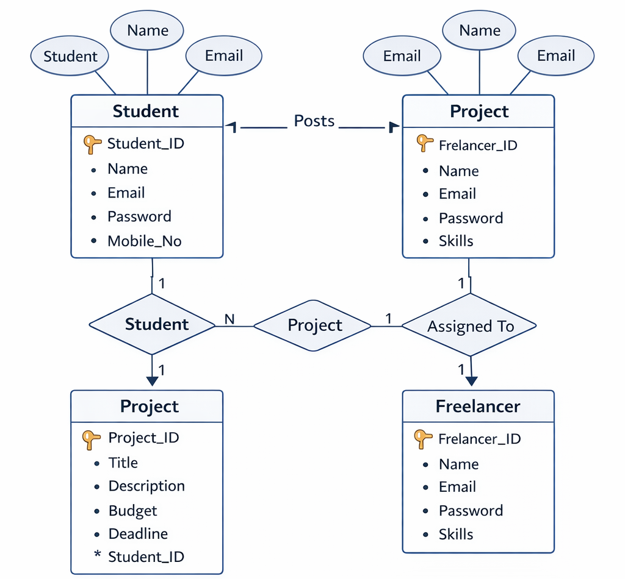
Flow of website

Slide 11
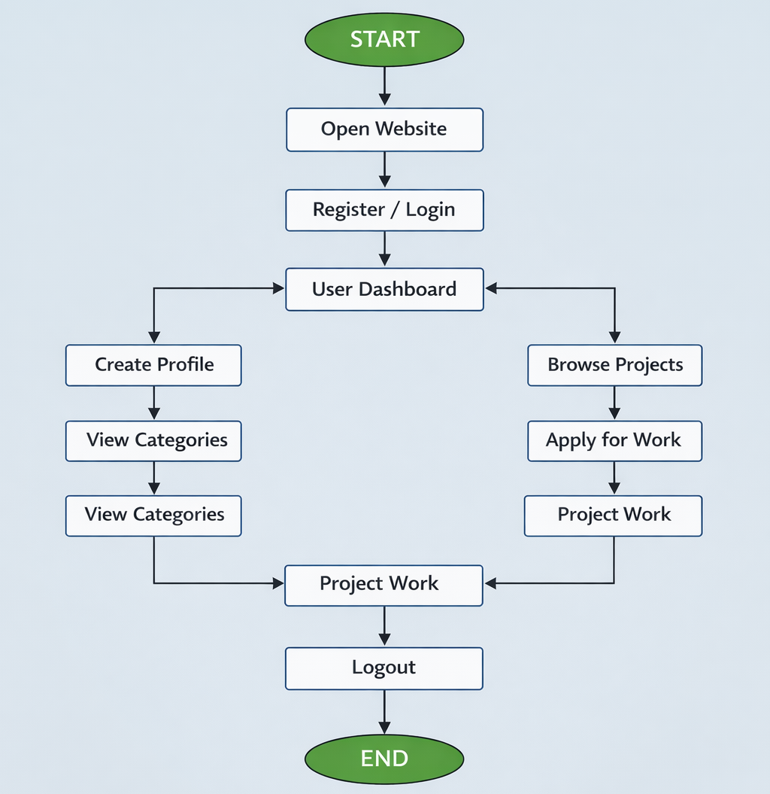
5. Details of designs, working & processes

Slide 12
5.1 Details of designs, working & processes
1. User Registration:
Student or freelancer creates an account.
User enters Name, Email, Password, Skills, Contact details.
Data is stored in the database.
2. User Login
Registered users log in using email and password.
System verifies credentials from the database.
If correct → user enters dashboard.
3. Project Posting
Student/Client posts a project or task.
Details include:
  Project title
  Description
  Budget
  Deadline

Slide 13
5.2 Details of designs, working & processes
4. Communication
Student and freelancer communicate through chat or messages.
Discuss requirements and progress.
5. Project Browsing
Freelancers can view available projects.
They choose projects based on skills and interest.
6. Project Completion
Freelancer completes the project.
Client reviews the work.
7. Admin Management
Admin manages:
  Users
  Projects
  Reports
  System data

Slide 14
6. Results and Applications
Results:
The system allows users to register and log in easily.
Users can browse different project categories.
The website provides a simple and user-friendly interface.
Applications:
Useful for web development, graphic design, content writing, and other services.
Can be used by students, professionals, and businesses.
Useful for services like web development, graphic design, content writing, and digital marketing.
Can be used by students and professionals to showcase their skills and portfolio.

Slide 15
7. Conclusion and future scope
Conclusion:
It allows users to register, create profiles, and explore project opportunities.
The Freelancer Website provides a platform that connects freelancers with clients.
The website demonstrates how web technologies can be used to build online service platforms.
Future Scope:
Development of a real-time chat system for communication between clients and freelancer.
Implementation of a rating and review system to maintain service quality.
Implementation of multi-language support for global users.

Slide 16
8. References and Bibliography
Upwork – Official Website. Available at: https://www.upwork.com
Fiverr – Official Website. Available at: https://www.fiverr.com
Freelancer – Official Website. Available at: https://www.freelancer.com
Flask Documentation – https://flask.palletsprojects.com
HTML, CSS, and JavaScript Documentation – https://developer.mozilla.org
Database Concepts – Silberschatz, Korth & Sudarshan, Database System Concepts.

